Slide 1



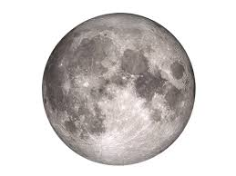

解密神奇的宇宙
Unlocking the secrets of the Universe
Session 4.2: from the Big Bang to colonizing the Universe
Is Earth a rarity or a necessity?
Today’s VIP guest list
In 1961 Mathematician Frank Drake published an equation estimating the number of worlds similar to Earth to be as high as 100 million (1亿). Around the same time, however, Enrico Fermi realized that if there are indeed so many potentially intelligent civilizations “out there” in the universe, then they should have already contacted humans, or at least we should be able to detect some trace of them.
However, until now we do not know of any other intelligent species sharing the Universe with us.
According to the Rare Earth hypothesis, planets such as Earth are actually very rare, and perhaps humans are the only, or one of extremely few civilizations in the Universe. In this session we will ponder this and related questions, looking to understand if Earth-like worlds – and human-like intelligent species – are at all possible and / or likely to inhabit other planets in the universe
Isaac Newton
Session objectives
Understand key ideas related to possibility of life in the Universe
Use several models to estimate probability of intelligent life in the universe
Discuss key challenges in contacting other intelligent species
Debate if Earth should maintain “radio silence” or actively seek out life in the Universe
Ponder the key difficulties in colonizing new planets and building an inter-planetary community
Key terms
SETI
搜寻地外文明计划
Drake Equation
德雷克公式
Light cone
光锥
Rare Earth Hypothesis
地球殊异假说
Fermi’s Paradox
费米悖论
Background Radiation
背景辐射

Slide 2

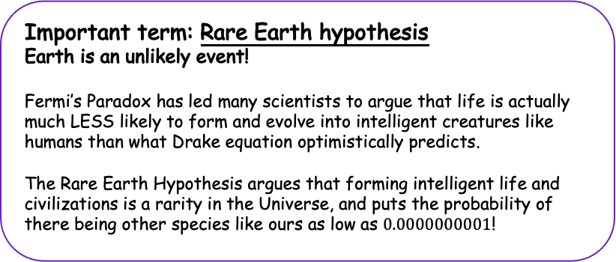
解密神奇的宇宙 Unlocking the Secrets of the Universe
SETI
搜寻地外文明计划
Search for Extraterrestial Intelligence (SETI) programs use various methods and technologies to search for traces of extra-terrestial life or communicating with other civilizations living outside of planet Earth
Drake’s Equation
德雷克公式
The equation estimating the number of intelligent civilizations in the universe.
Fermi’s Paradox
费米悖论
We can estimate the number of intelligent civilizations like ours in the universe to be quite high, and yet we find no traces of them, nor have we ever been visited by them.
Rare Earth Hypothesis
地球殊异假说
The hypothesis that states that planets like Earth – habitable to creatures similar to us – are extremely rare
Where is everybody?
Drake’s equation is a famous attempt at estimating the number of intelligent civilizations in the Milky Way Galaxy (银河).
Drake’s equation estimates this number to be as high as 100m (1亿)!
This led another famous physicist Enrico Fermi to ponder: “Where is everybody?” – if there is indeed so many intelligent species like us in our Galaxy, we should have already been contacted by them, right? Or, at the very least, we should be able to find some traces of other civilizations, spaceships, byildings, etc. – yet, we have so far discovered no traces of other intelligent species anywhere in the portion of the universe we observe. This apparent paradox called the Fermi’s Paradox.
Where do you think “everybody” has gone to?
Important term: Rare Earth hypothesis
Earth is an unlikely event!
Fermi’s Paradox has led many scientists to argue that life is actually much LESS likely to form and evolve into intelligent creatures like humans than what Drake equation optimistically predicts.
The Rare Earth Hypothesis argues that forming intelligent life and civilizations is a rarity in the Universe, and puts the probability of there being other species like ours as low as $0.0000000001$!
What do you think are some of the key assumptions of the Rare Earth Hypothesis that decide that thew probability it estimates is so low?
What are different factors and constants that decide this probability?
Which of these constants can we estimate with high degree of certainty? What about the other ones?
JinJin STEM Academy

Slide 3
解密神奇的宇宙 Unlocking the Secrets of the Universe
“Common Earth hypothesis”: are we actually pretty likely to happen?
There are certain factors that actually can be considered to make life forms such as humans quite likely to appear in the Universe.
What would be factors making Earth-like organisms likely to appear and evolve in the Universe?
Even if it is unlikely, can it be said that existence of life such as life on Earth is impossible? Why / why not?
A new approach uses Bayesian methods to model the probability of intelligent life emerging and evolving in the universe.
1
Important term: Bayes estimation
Bayesian estimation first makes an assumption about the probability of certain phenomenon, for example based on some limited experimental data. As more data becomes available, this assumption is updated and improved.
In case of estimating the probability of there being intelligent life in the universe, we unfortunately only have 1 data point to build our model predicting the probability of life: mainly the Earth itself.
Look carefully at the statements below. Can you understand the difference in how they are formulated? Can you see why their probabilities should be different?
Life is rare, intelligent life is rare | Life is not rare, but intelligent life is rare
Life is rare, intelligent life is not rare | Life is not rare, intelligent life is not rare
JinJin STEM Academy

Slide 4
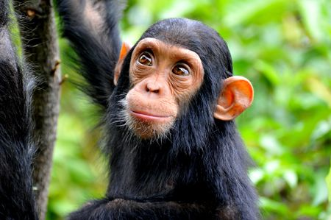

解密神奇的宇宙 Unlocking the Secrets of the Universe
I could swear I saw them here just a million years ago…
It is also possible that we just “missed” other civilizations coming to the Solar System for sightseeing. Recall that – at least as far as modern science goes – nothing can travel faster than light, and this includes information. It is not impossible that the region of space our technology can reach simply does not intersect with regions that other species can ever get to.
Extra-terrestial species: should we be even looking?
Suppose the Universe is actually crowded with other species, and even intelligent life is not rare at all. What are the dangers and opportunities of actively looking for other civilizations?
What could be some arguments for maintaining “radio silence” to hide from other civilizations that might be “out there” in the universe?
First contact challenges
1
What if other intelligent species exist, or even are here right now, but we simply can’t interact with them?
Recall that dark matter permeates the universe in huge quantities, but we simply do not have a way to interact with it and can only see some effects it has on reality and “normal” matter.
What if aliens are also like this? Can you brainstorm some ways in which we might be unable to communicate with aliens even if they are all around us?
Humans vs. chimps
When we compare ourselves to our closest animal cousins: chimpanzees, we can notice that our DNA only differs from chimp DNA by around ~2%.
However, we are many orders of magnitude more intelligent than chimps: we not only think faster, but are capable of creating art, building space rockets and forming societies.
It is not impossible that an alien species can be only slightly different from us biologically, but at the same time being infinitely more intelligent than us – to such species, we might appear what chimps appear to us: ”just animals”.
Would such species even ”bother” to visit or contact Earth? Would they even notice us?
Another theory claims that we have already discovered aliens, or traces of alien civilizations, but all this data is kept secret by governments for safety and other reasons. What do you think of this hypothesis? Is it possible? Is it likely? Is it compelling?
JinJin STEM Academy

Slide 5
解密神奇的宇宙 Unlocking the Secrets of the Universe
Space colonies: challenges, dreams and harsh reality
Colonizing the Universe is a appealing idea: humans could expand to new planets, improve our understanding of the Universe, solve Earth’s overpopulation problem as well as use resources from other planets. Unfortunately, “getting there” is tricky.
What are some challenges related to long-distance space travel, as consequence of Newton’s gravity, Special Relativity and General Relativity?
Should we colonize space?
What gives humans the “right” to travel to other planets and use their resources?
Think about how humans colonized different places throughout history, and what this has been causing to the planet.
Should we “let ourselves” exploit other parts of the universe? Why / why not?
1
Session Summary
Life on Earth, and its evolution into intelligent humans, is a product of many accidents and random events, some of which are quite unlikely to happen, but this does not necessarily mean that life in Earth-like form is unlikely
There are multiple models to estimate the number of intelligent civilizations in the universe. The optimistic ones, such as Drake Equation, estimate this number to be very high. Pessimistic models show it is “almost impossible”. All models depend on some constants and assumptions about the universe that we often can only guess.
Colonizing the Universe is difficult not only because of limitations imposed by physics, but also due to financial and even ethical considerations.
Questions to ponder
What are the key challenges with finding and contacting alien civilizations?
Should we colonize other planets, or even other star systems and galaxies?
What are some risks related to SETI projects looking for traces of other civilizations in the universe?
JinJin STEM Academy

